Slide 1
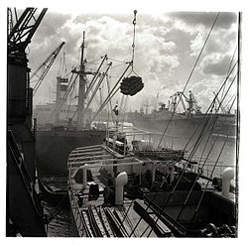
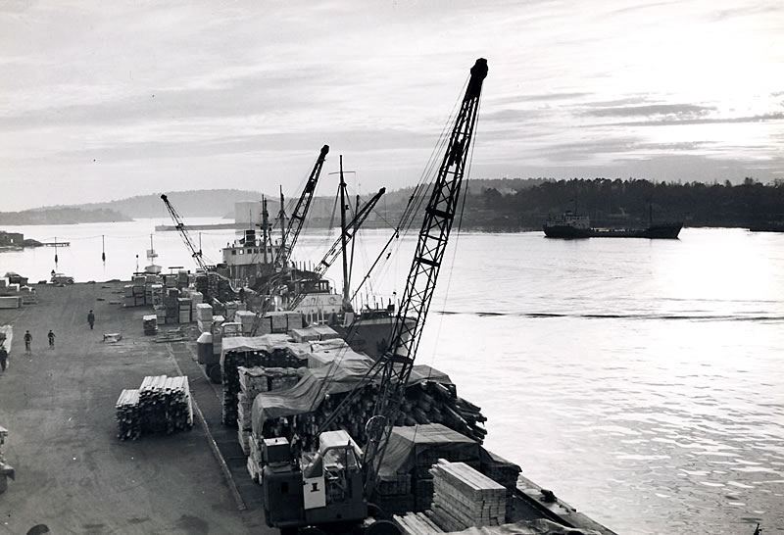
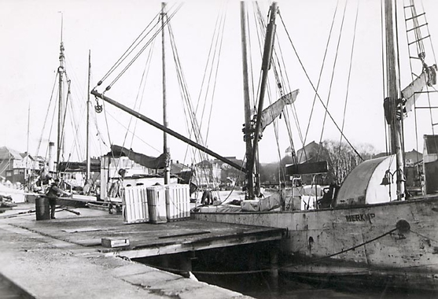
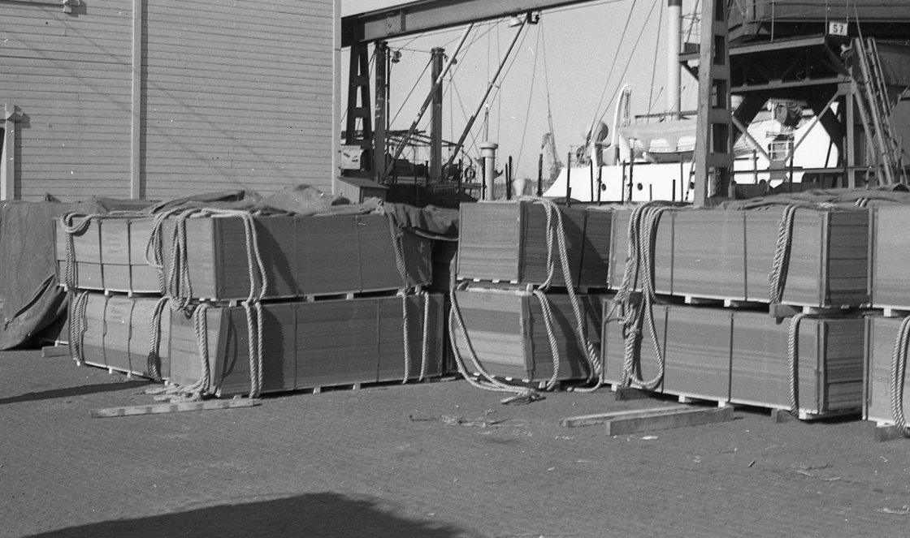

Slide 2
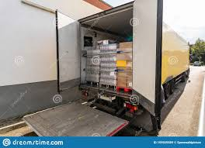
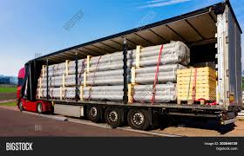
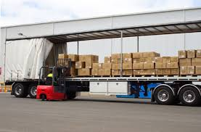
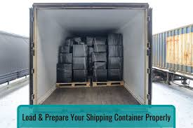
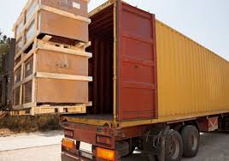
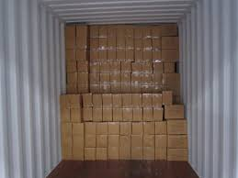

Slide 3
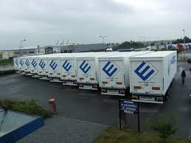
Load carrier
Requirements for unit load
High concentration of goods flow
The flow of goods must be regular
The logistics chain can contain several means of transport
Application
Standardized load carriers
Container, Trailer
Can be used intermodally
Lake, road and rail

Slide 4
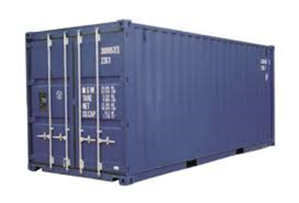
Load carrier
Type 20' TEU DV
Twenty-foot Equivalent Unit
Dry van
LxWxH ext 6058x2438x2591
LxWxH inv approx 5900x2350x2370
Palletwide 2.44 wide
Volume 33 m3
Tare weight approx. 2200 kg
Cargo cap . approx. 21800 kg

Slide 5
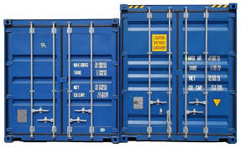
Load carrier
Type 40' (= 2 TEU )
LxWxH ext 12192x2438x2591
LxWxH inv approx 12050x2350x2370
Palletwide 2.44 wide
Volume 67 m3
Tare weight approx. 3900 kg
Cargo cap . approx. 26600 kg
type 45'
Length 13.7m
High cube
Height 2.69m
40' and 45'
Containers in all sizes are also available for refrigerated and frozen goods

Slide 6
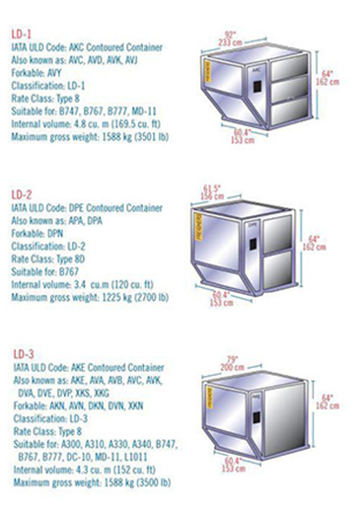
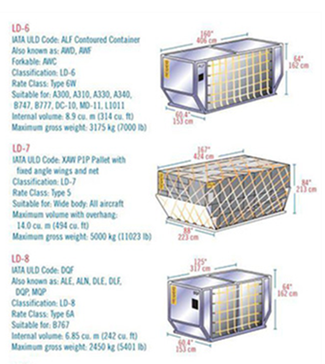
Cargo carrier flight
ULD
Unit Load Device
Airline property
Companies that rent out
Used only in the air transport system

Slide 7
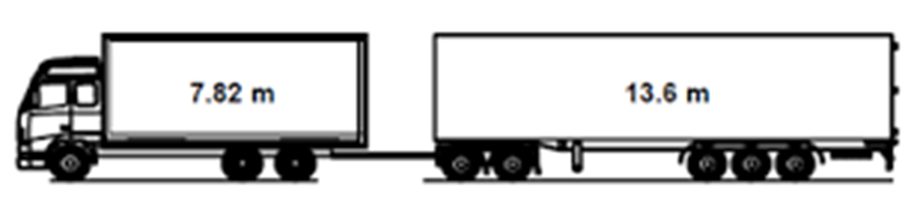
Load carrier
Car & trailer
Outer dimensions :
Height: 4.2 m Width: 2.6 m Length: 24-25 m
Number of axles: + 5
Approx. Inner dimensions:
Height: 2.95 m Width: 2.48 m Length: 20.0 m
Total weight = load and vehicle 60,000kg – 74,000kg
Load capacity: 40,000 kg – 50,000 kg

Slide 8
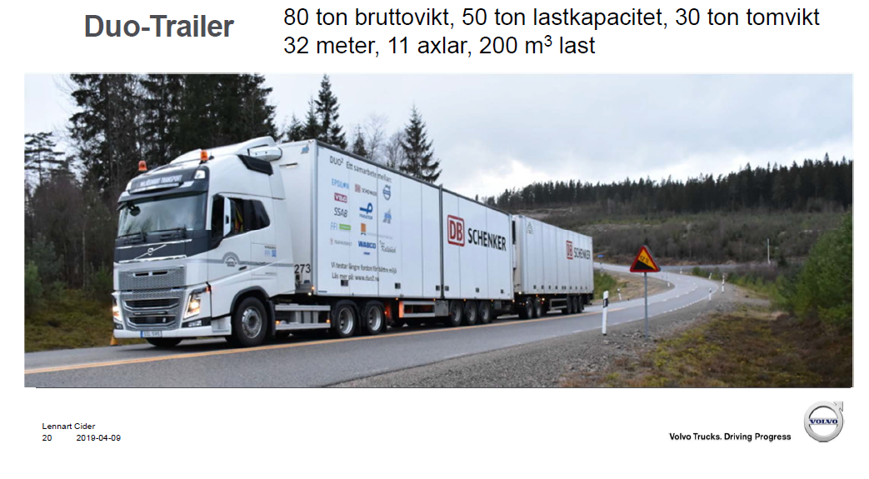
Load carrier
HCT vehicle – High Capacity Transport
New law 31 August 1 December 2023

Slide 9
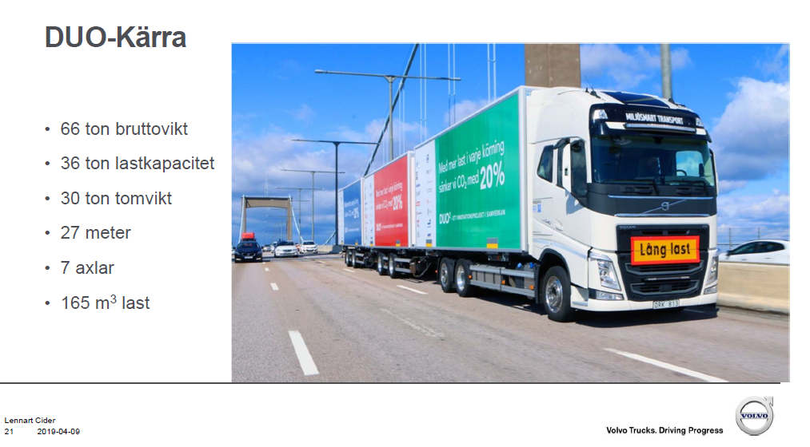
Load carrier
HCT vehicle – High Capacity Transport

Slide 10
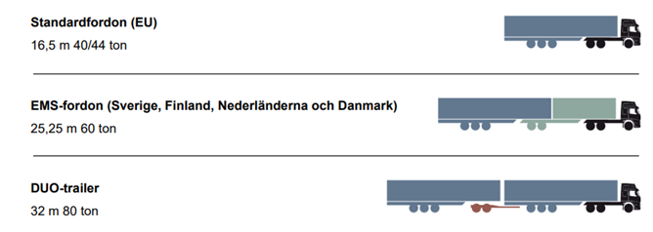
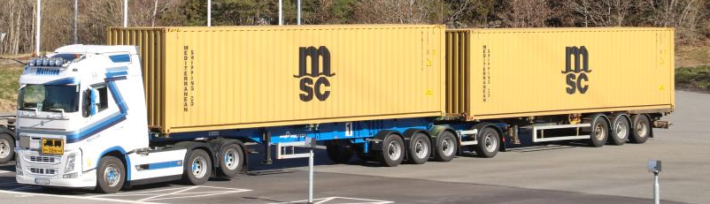
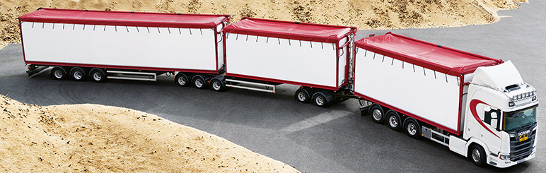
18.75 m
Total weight of cargo + vehicle
60 – 74 tonnes
Total weight of cargo + vehicle
HCT vehicle – High Capacity Transport
Total weight of cargo + vehicle
2 40' (foot) containers = 2 x 12 meters
Vehicles with three trailers
7.82m + 7.82m + 13.6m
Picture: Dan Boman Scania CV AB
Notes:
27% less fuel and CO2 emissions

Slide 11
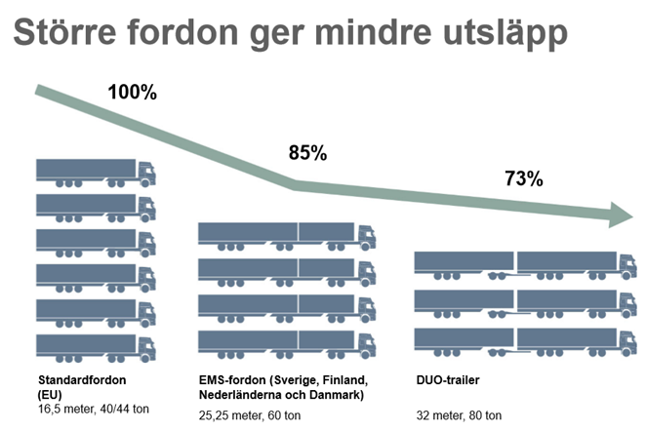
HCT vehicle – High Capacity Transport
18.75 m

Slide 12
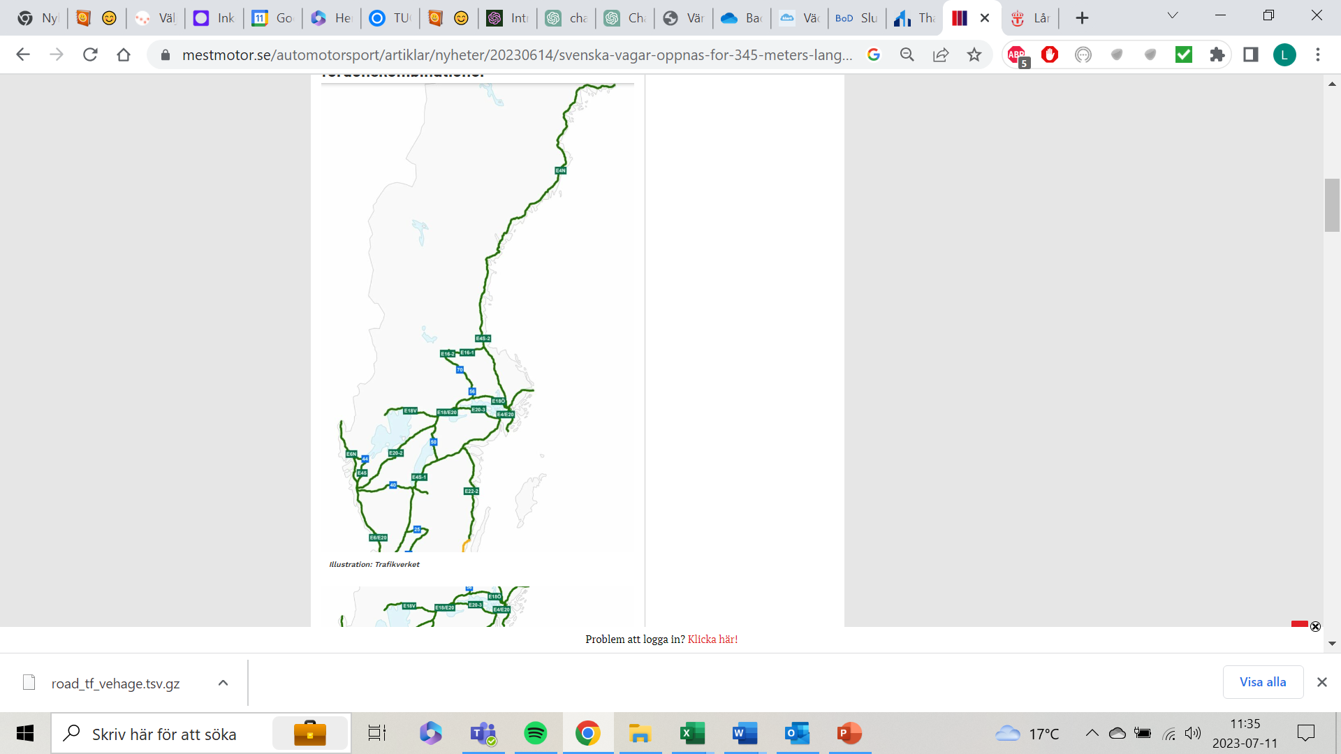
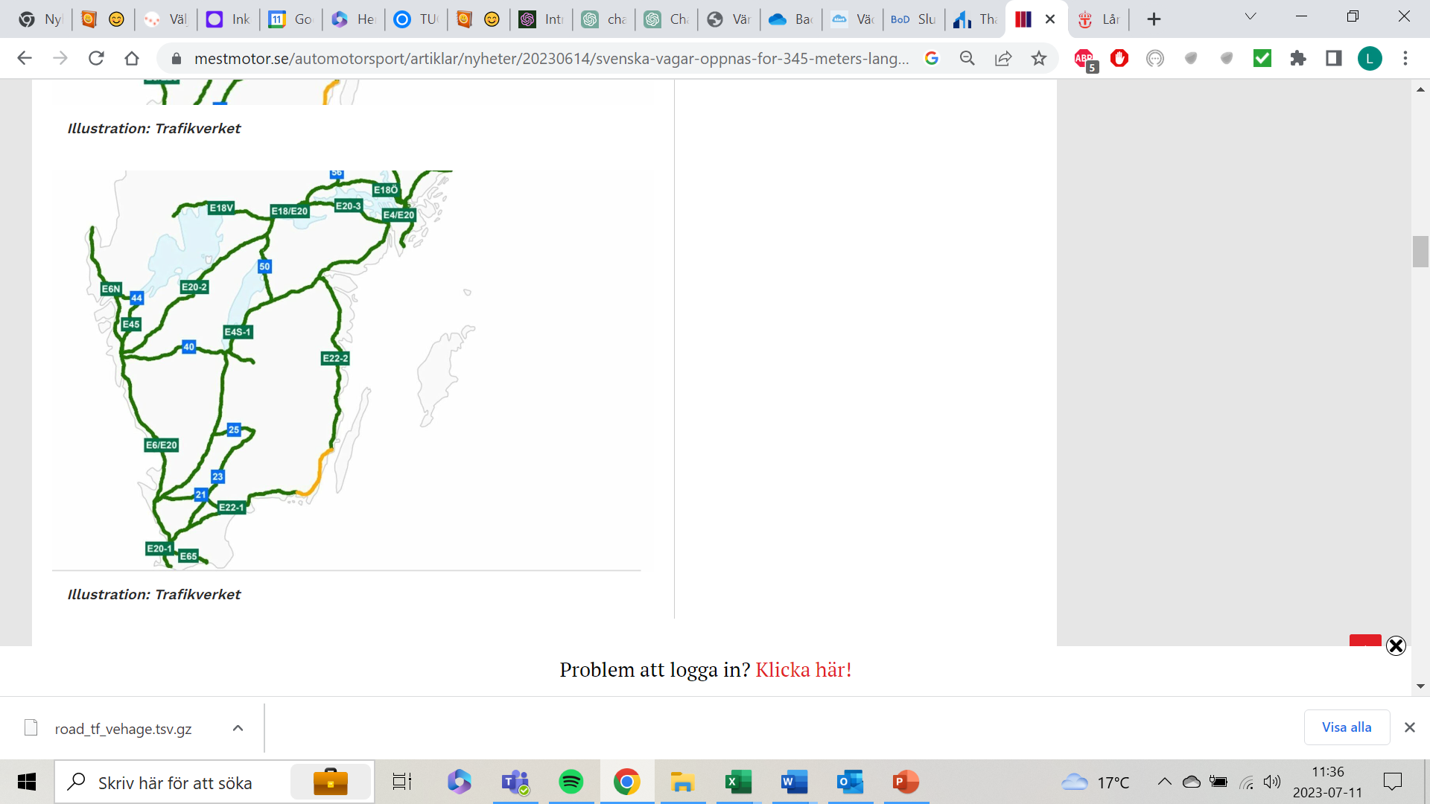
HCT vehicle – High Capacity Transport
590 miles of state roads from 1 Dec 2023

Slide 13
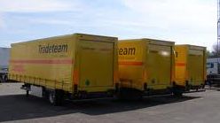
Load carrier
Road transport
Trailer
Outer dimensions Height: 4.0-4.2 m Width: 2.55 m Length: 13.9 Inner dimensions: Height: 2.7 Width: 2.48 m Length: 13.6 m Load capacity: 26,000 kg
Permitted weight in Europe 24,000kg
Length including tractor
18.75 m

Slide 14
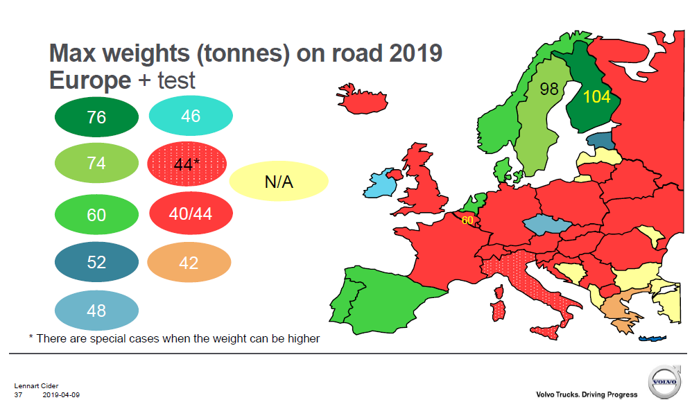
Load carrier

Slide 15
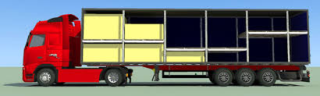
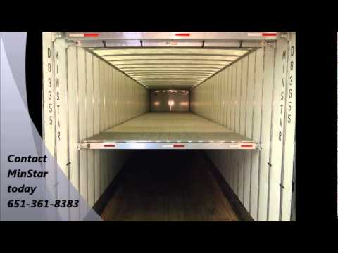
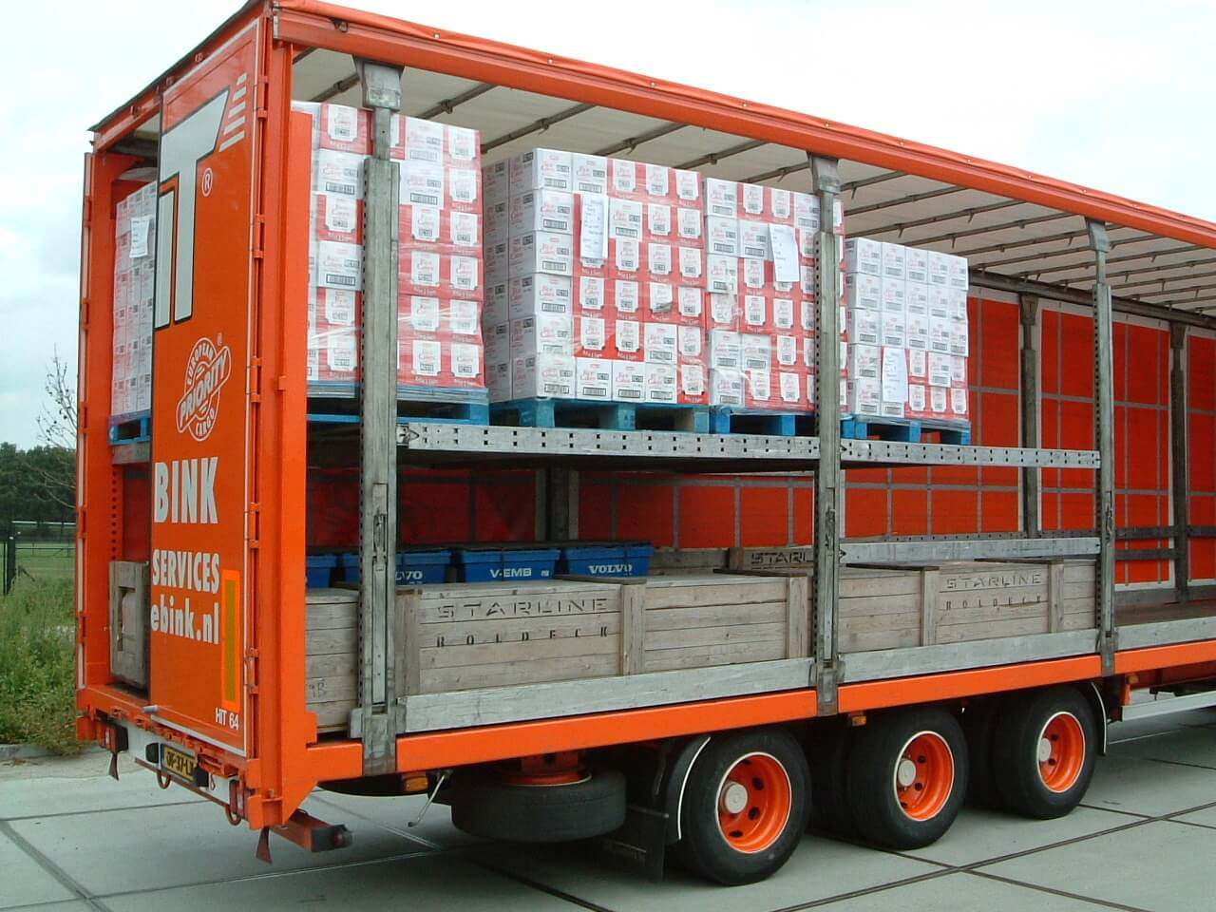
Load carrier
Trailer Double-decker

Slide 16
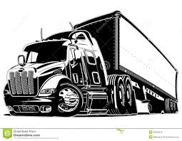


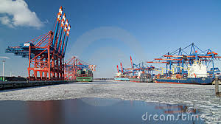
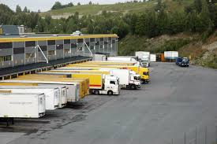
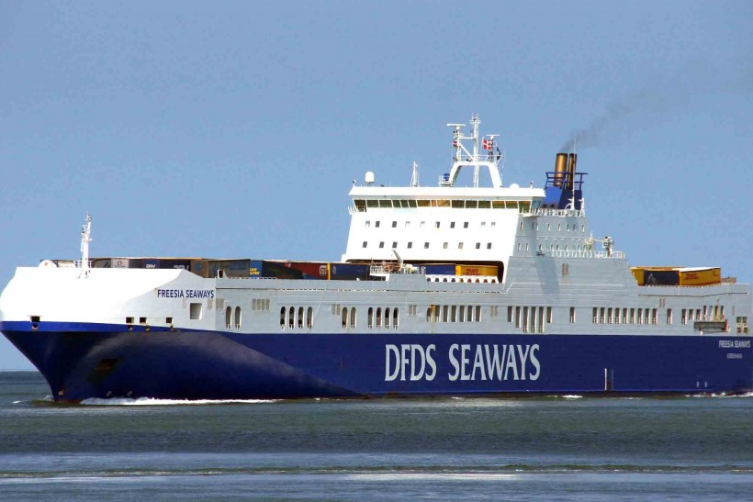


Forwarder/ Logistics company
Hauling
Ports
Collaborative partners outside Sweden
Freight terminals/ Hubs
Train operator
Airline
Shipping company
Collaborative partners within Sweden

Slide 17

Freight companies
The business
Transport manager
Geographic areas
Vehicle
Driver

Slide 18

Terminal system and transport system domestically
Hauliers domestic transport
Bid transport – Freight transport
Single car rider – Multiple vehicles
Operation
Subcontractors
DHL, Schenker, DSV etc
Included in network
Intermediary
For example, the Transporter
Connected to LBC, Lastbilscentral
E.g. GLC Göteborgs Lastbilscentral
Has transshipment terminal

Slide 19
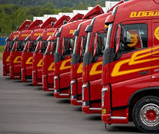
Freight companies
Local transport
Distribution
Long-distance transport
Tow truck operation
International haulage companies
Food
Refrigerated and frozen transport
Construction and construction
Cleaning
Special transport
Agricultural transport
Animal transport
Tank transport
Log transport

Slide 20
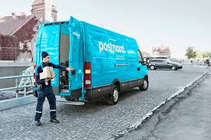
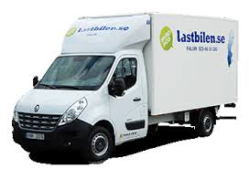
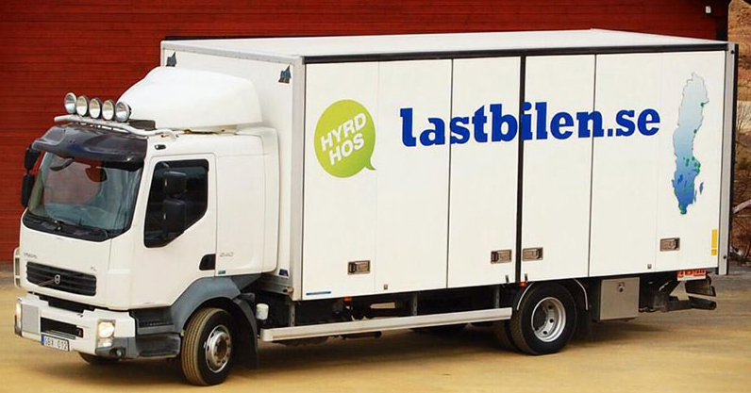
Freight companies
The business
Local distribution
In cities
Smaller geographic areas
Smaller vehicles
Light Truck
Total weight up to 3500kg
Load weight approx. 1000kg
Heavy truck
Total weight 23000kg
Load weight approx. 7600kg
About 6 pallets

Slide 21
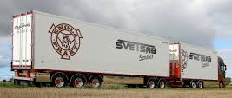
Freight companies
The business
Long-distance transport
Transport between cities
Vehicle
Car and trailer 24 - 25m
Trailer 13.6m
HCT vehicle
Up to 34.5 m
Consolidation
Many companies' goods
To/From the same area/city

Slide 22


Freight companies
The goods owner's transport needs
Package
< 100 kg
General cargo
< 2500 kg
Party goods
> 2500 kg
Hellest, full car
> 20,000 kg

Slide 23
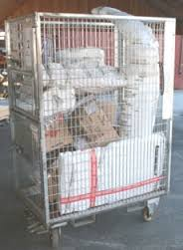
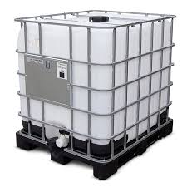
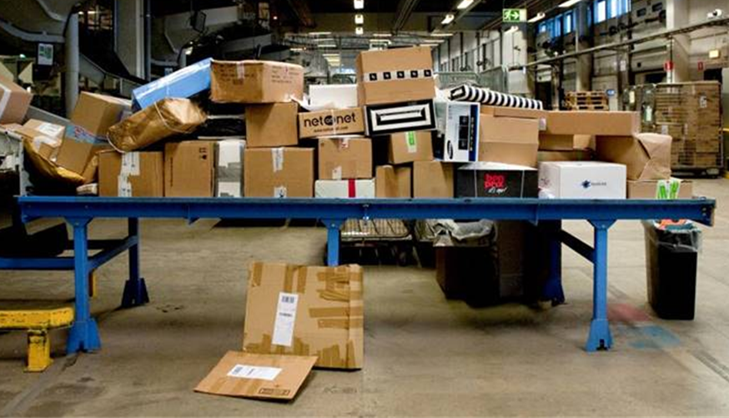
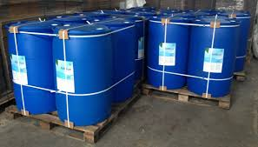
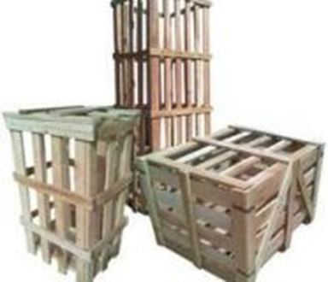
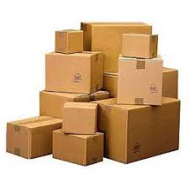
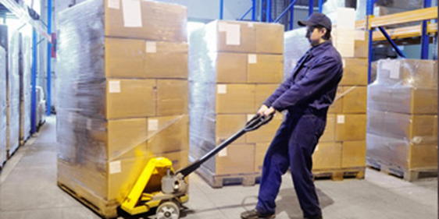
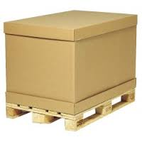
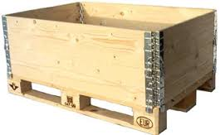
Freight companies
Packages and piece goods

Slide 24
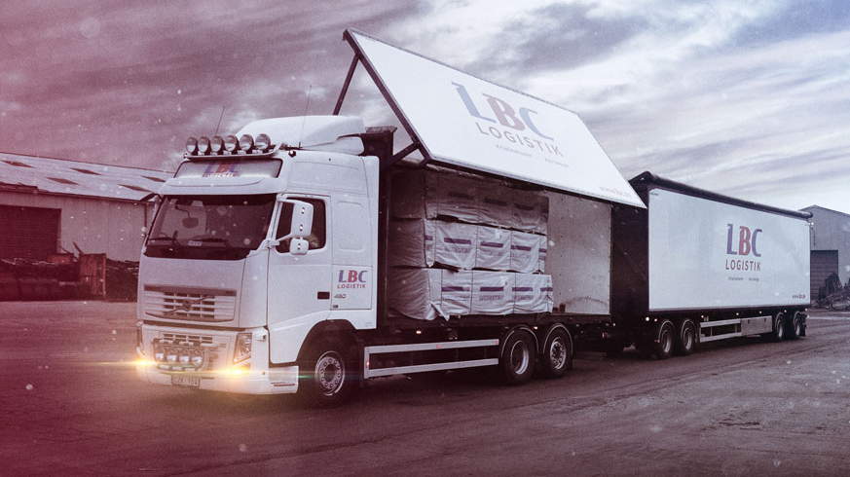
Freight companies
Bulk goods 2500kg – approx. 18,000kg
Loaded at the sender
Unloaded at the receiver
Same vehicle
Door/Door
Hellest
The goods owner books the entire load carrier

Slide 25
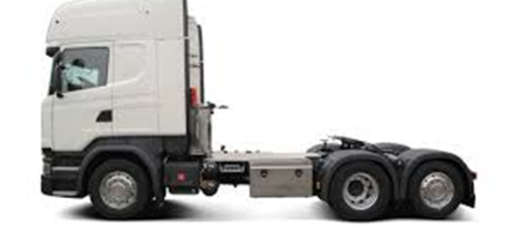
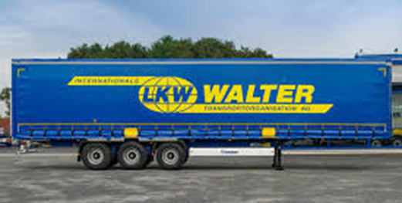

Freight companies
Tow truck operation
Loose trailer system
Often used in international traffic
Vehicles without load carriers
The load carrier is owned by
Forwarding agent
Logistics company
The load carrier
13.6m trailer
Driver
Employees of the haulage company
The assignments
Comes from forwarders and logistics companies

Slide 26



Freight companies
Towing companies
Container
Chassis
One chassis = 2 x 20ft alt 1 x 40ft
(20ft = 6m long 40ft = 12m long)

Slide 27

Freight companies
Towing companies
Swimming lift
Chassis with crane
Possibility to take off
Used when there is no loading dock

Slide 28

Freight companies
International haulage companies
Whole crew
Owns tractor and trailer
Principal
Forwarders
Logistics company
Goods owner
Specialized
Geographic areas

